Slide 1
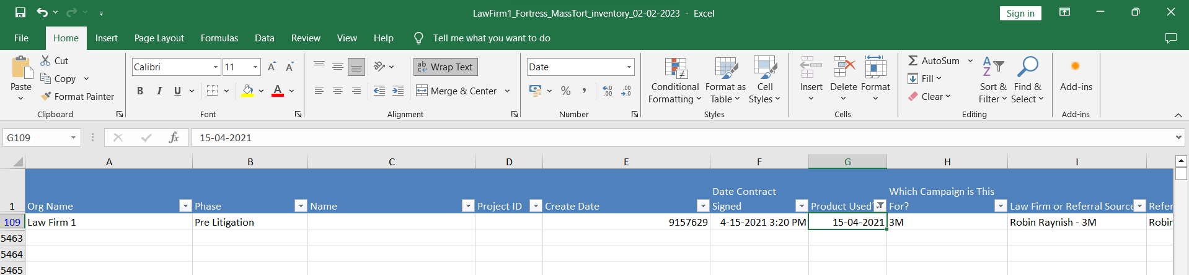
Unexpected value in Product Used – Dropped

Slide 2
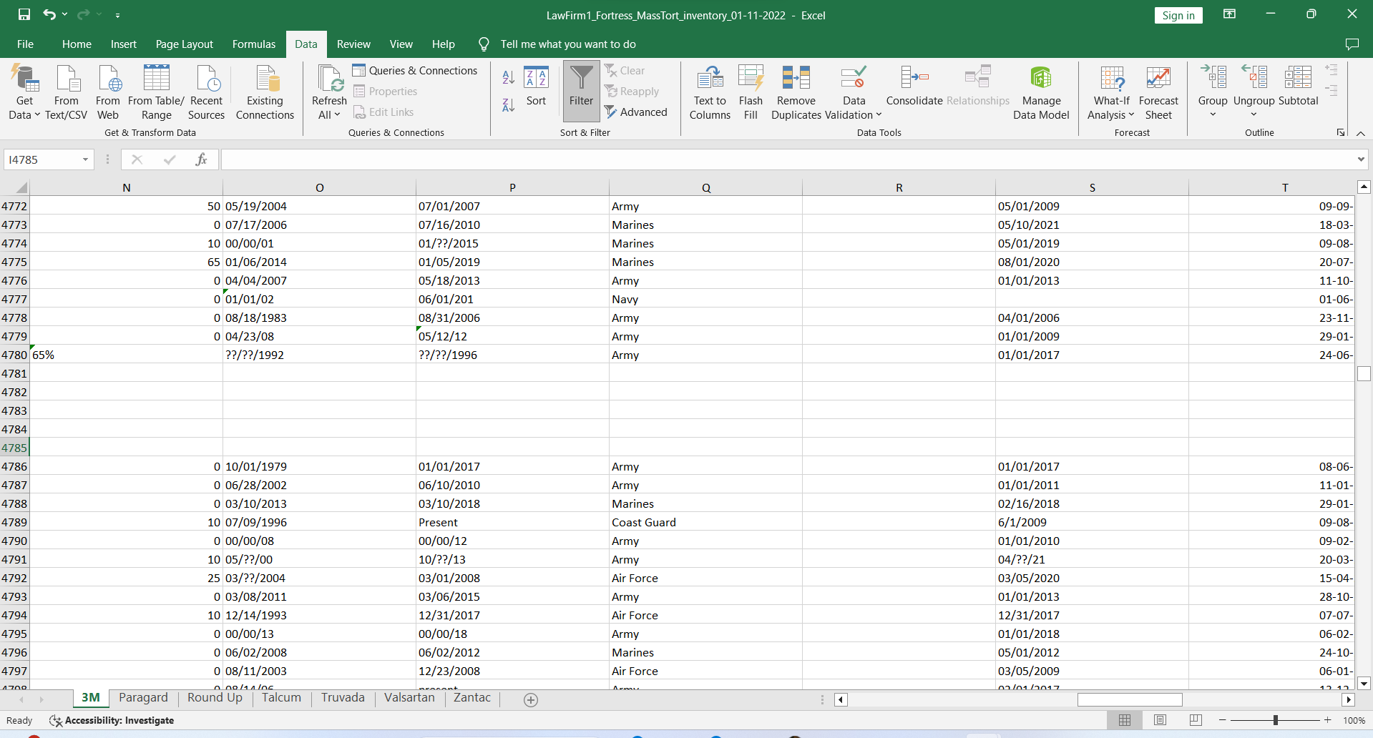
Partial filled rows in 3M sheet
<to be deleted>

Slide 3
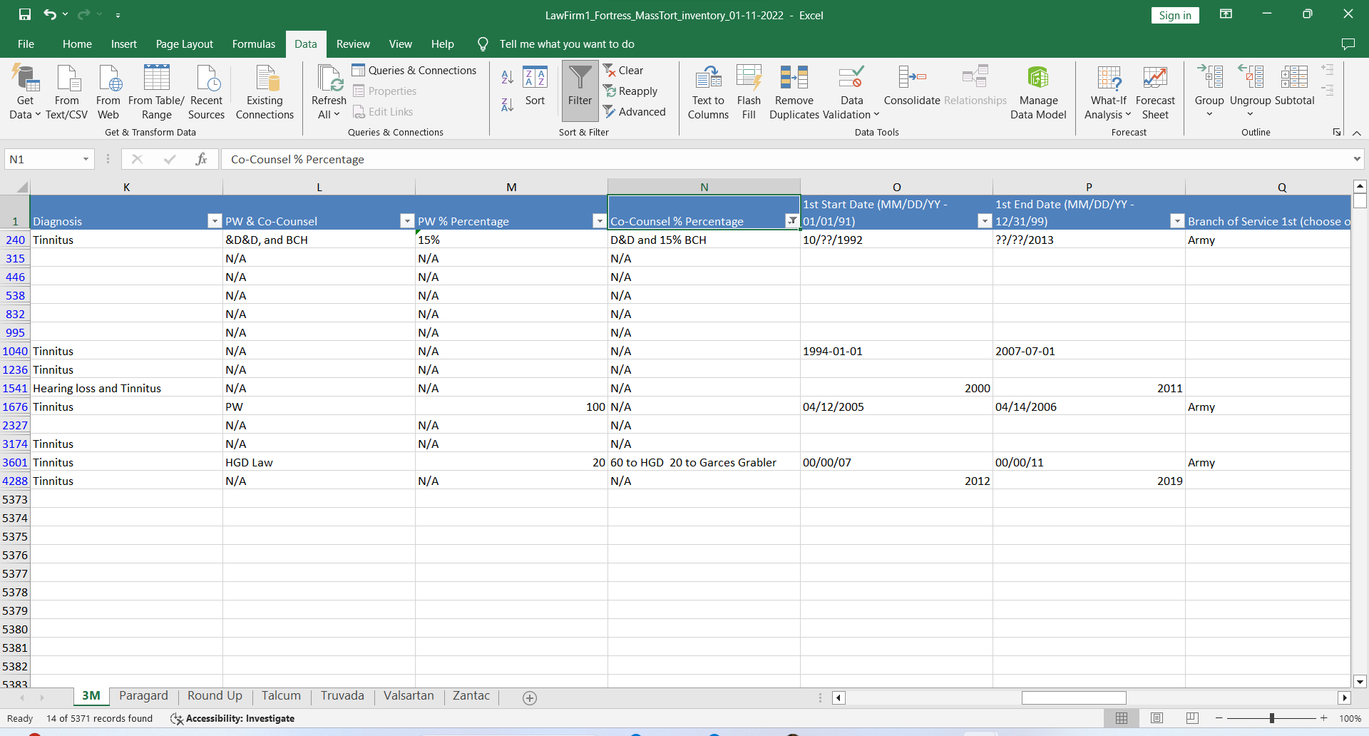
Text in co-counsel % Percentage and PW% percentage

Slide 4
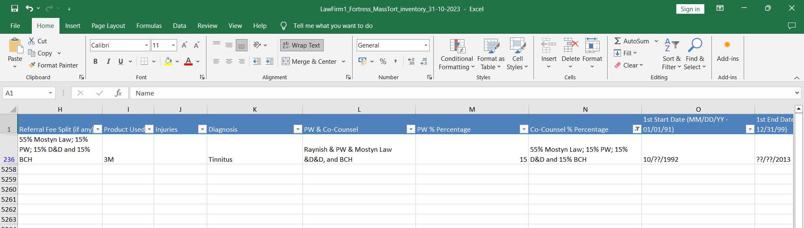
Some more

Slide 5
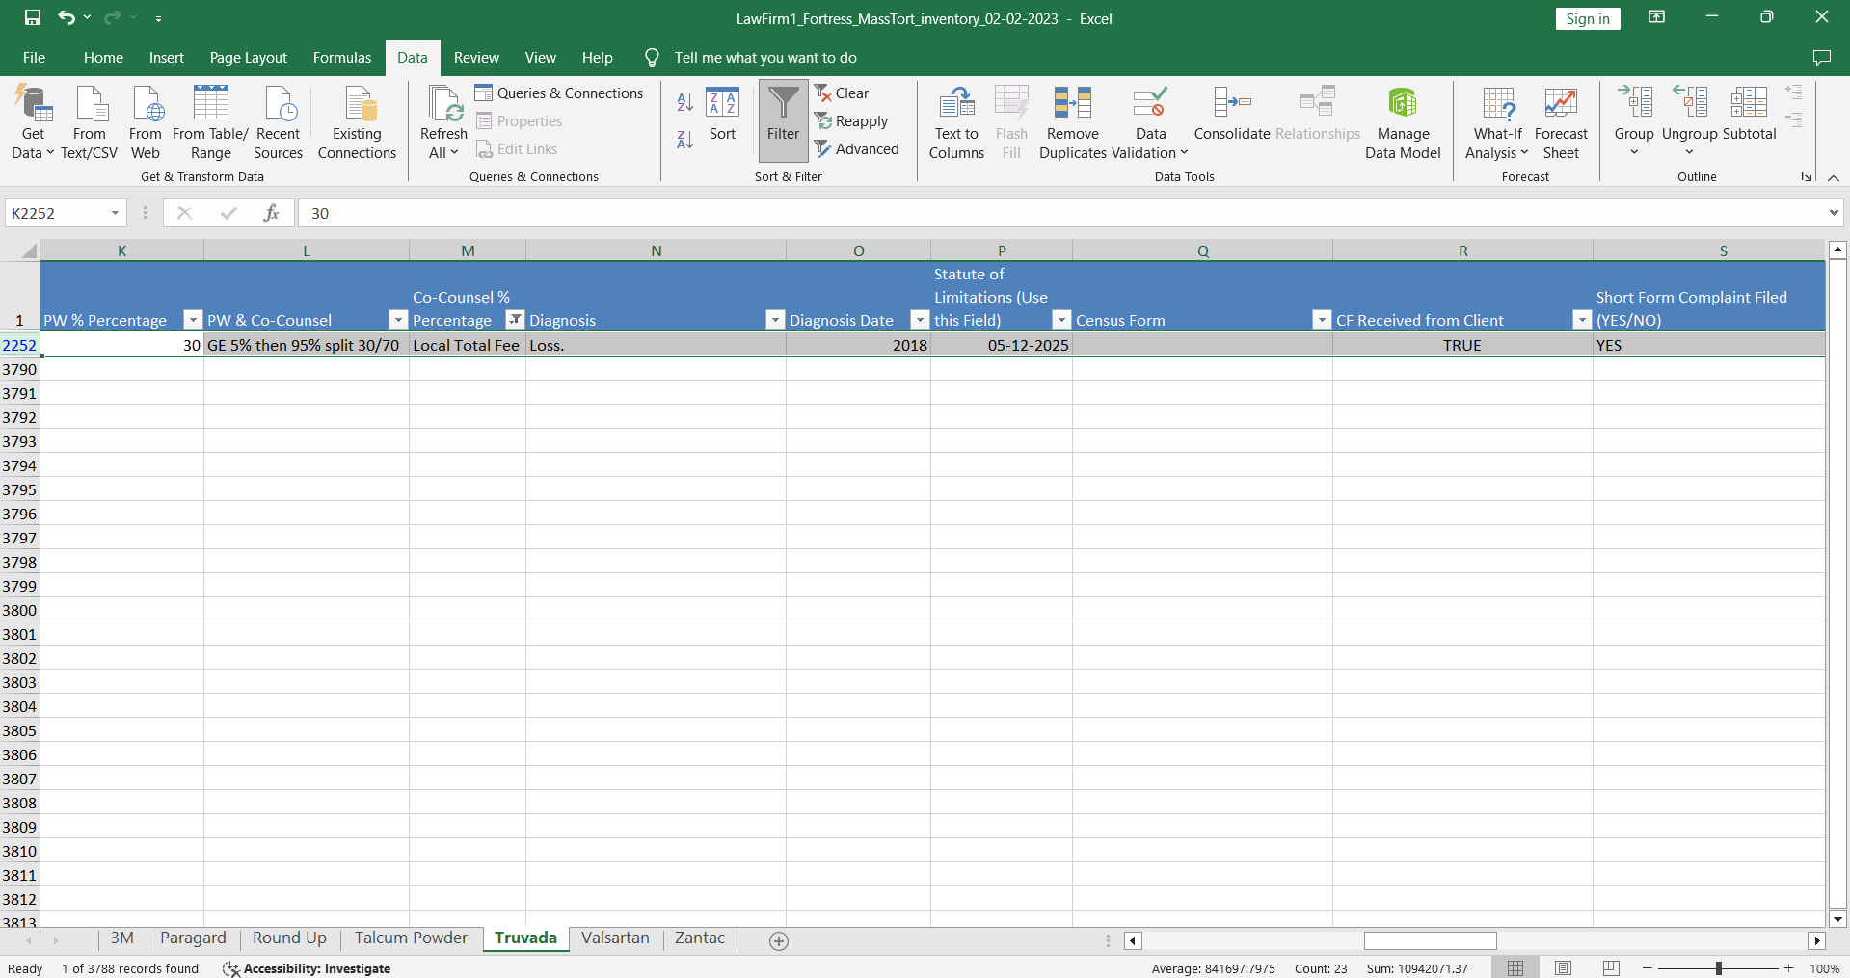
Dropped

Slide 6
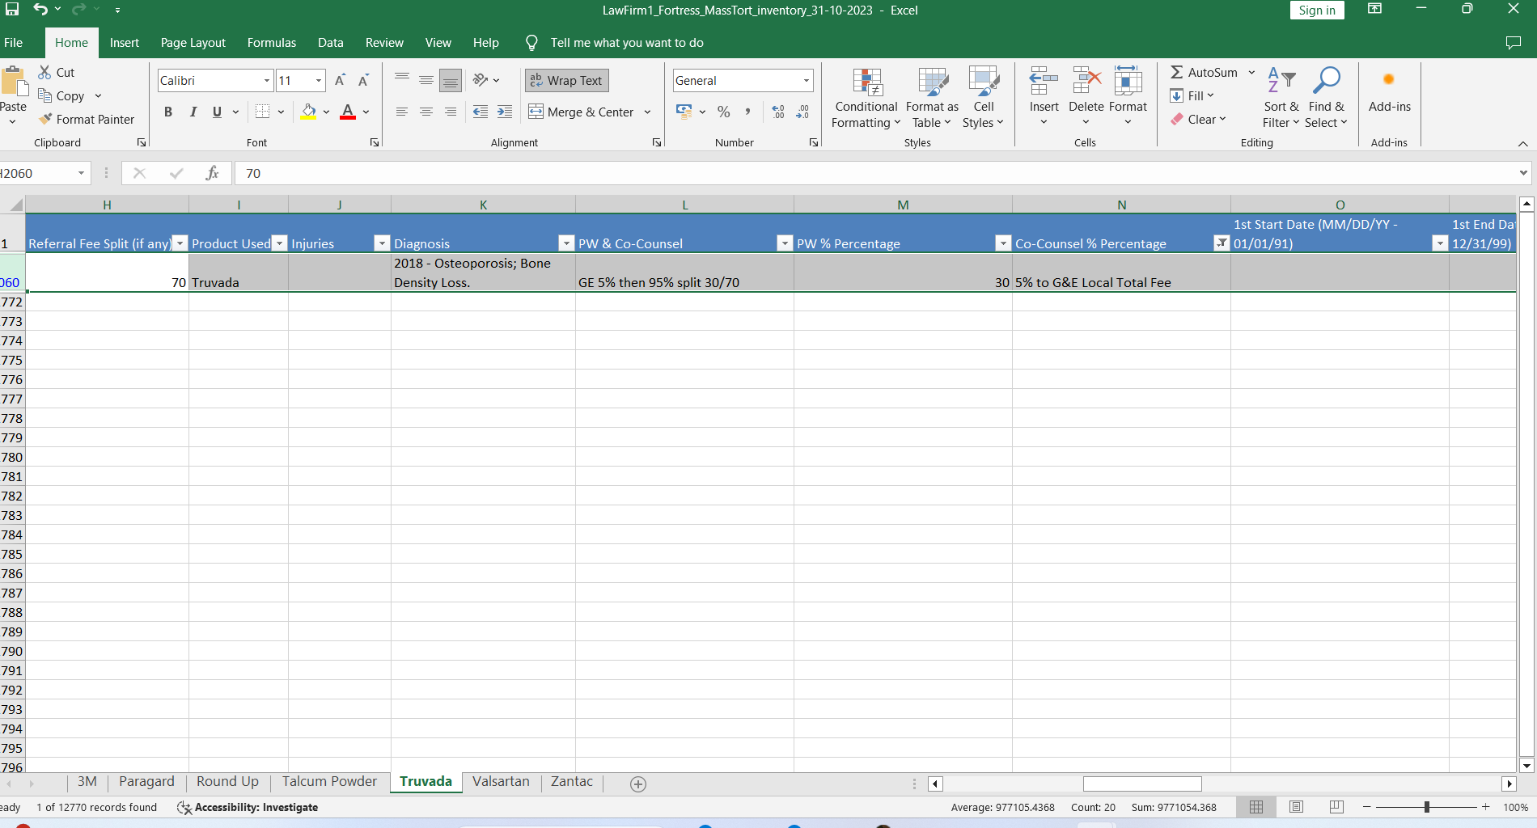
Dropped

Slide 7
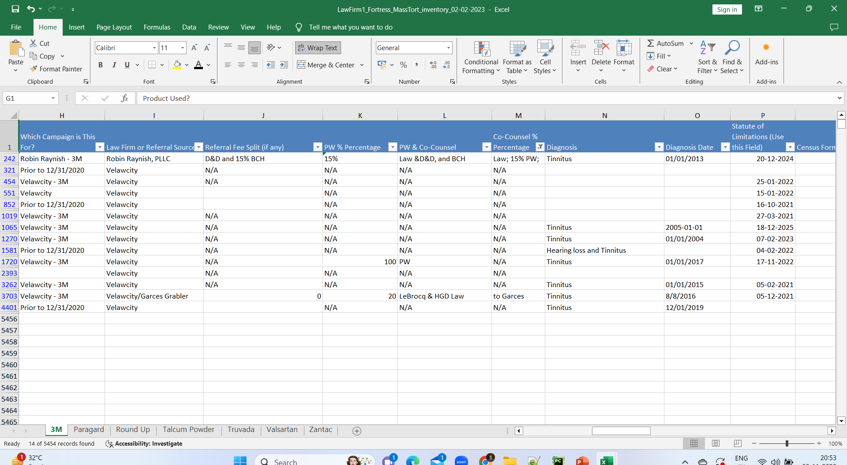
Dropped

Slide 8
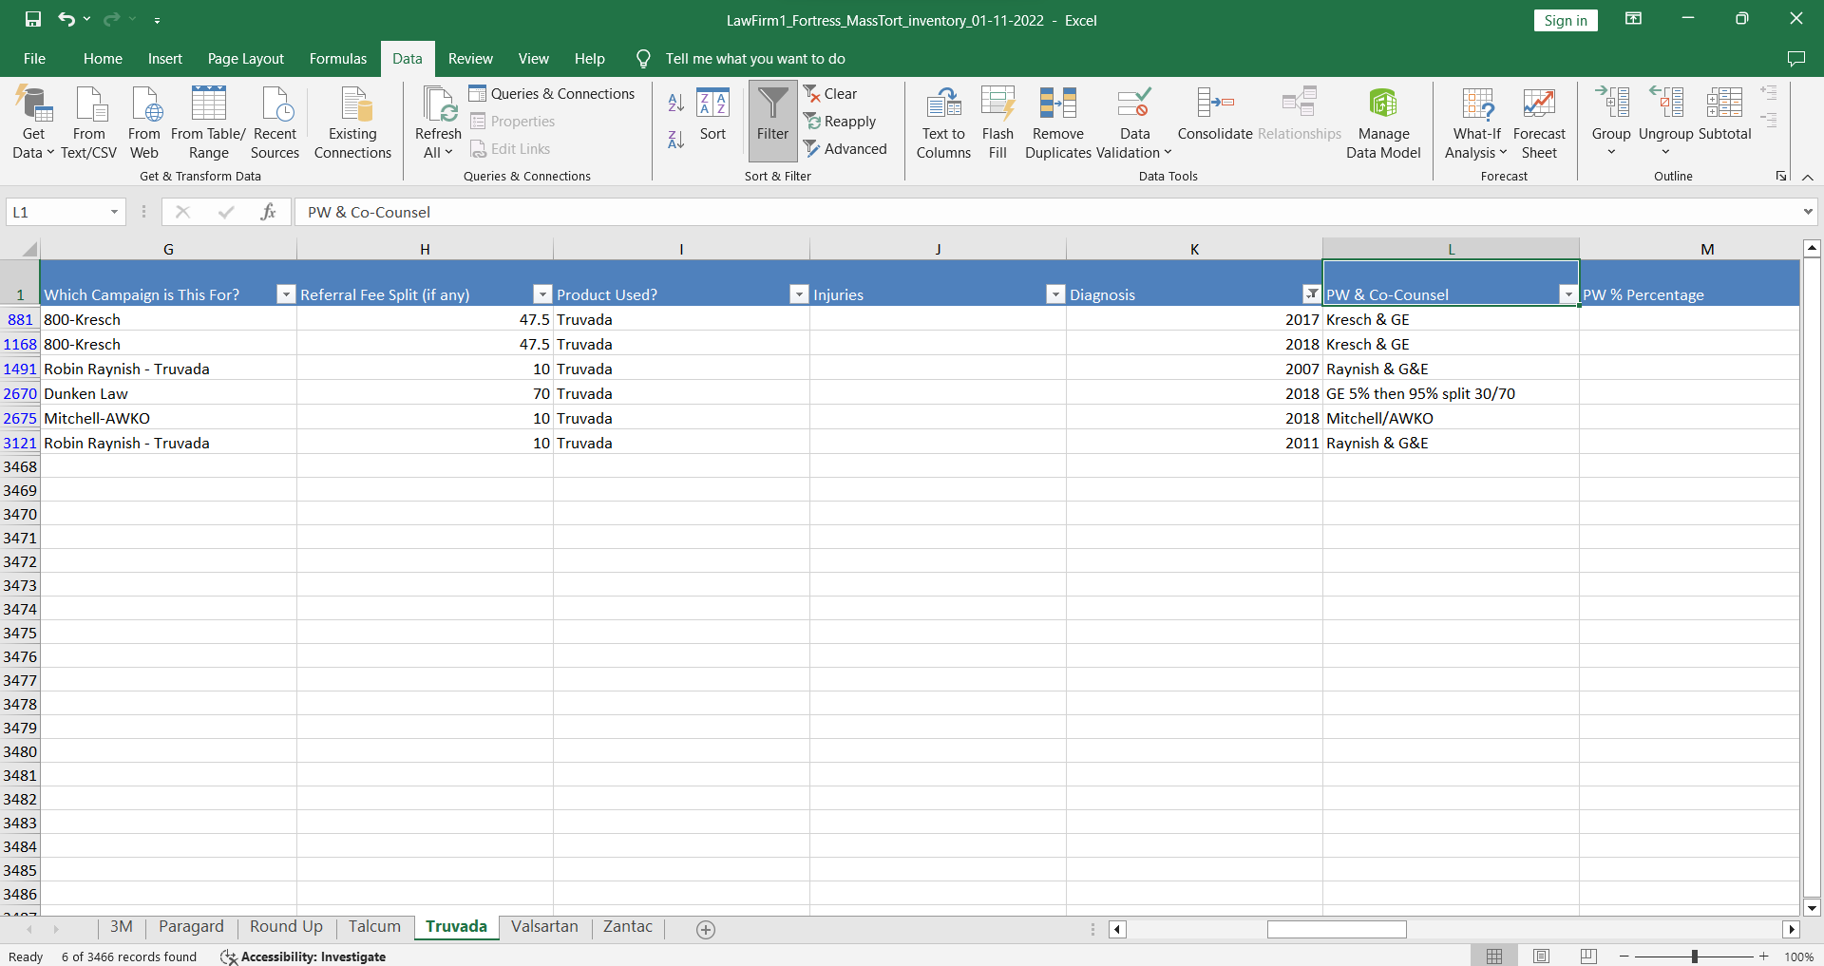
Dropped

